Slide 1
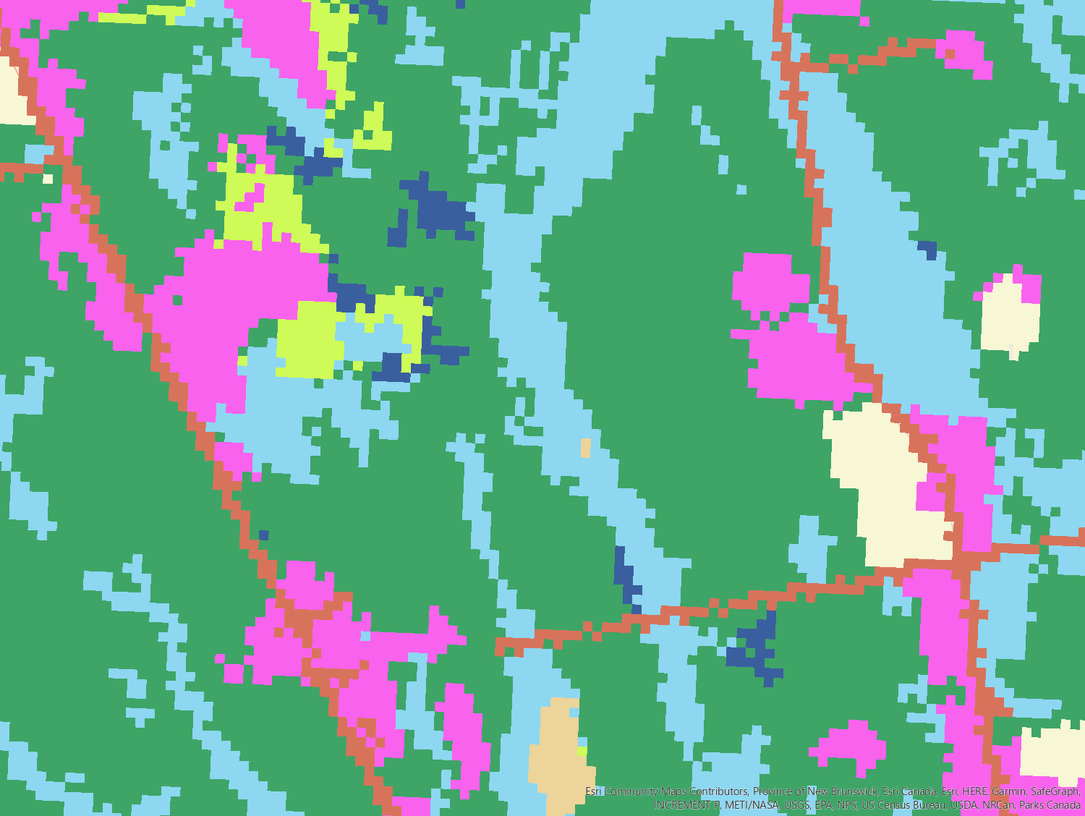
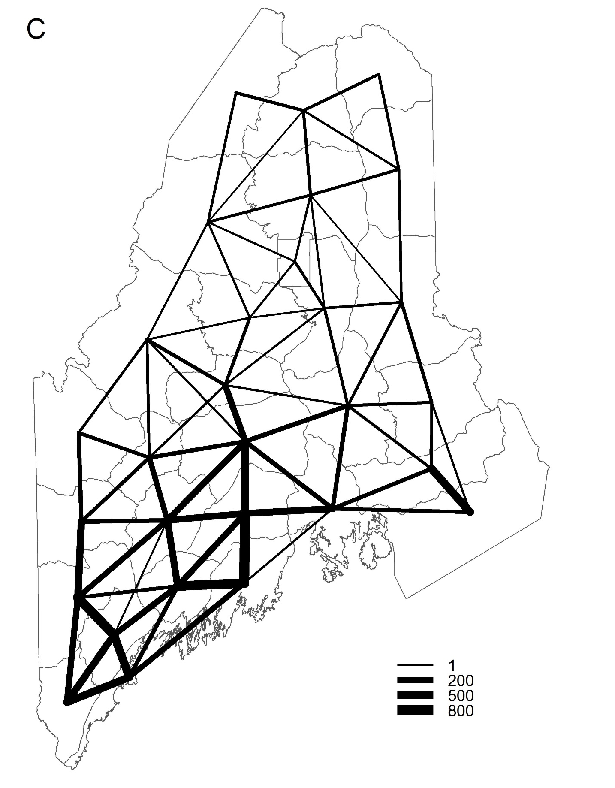
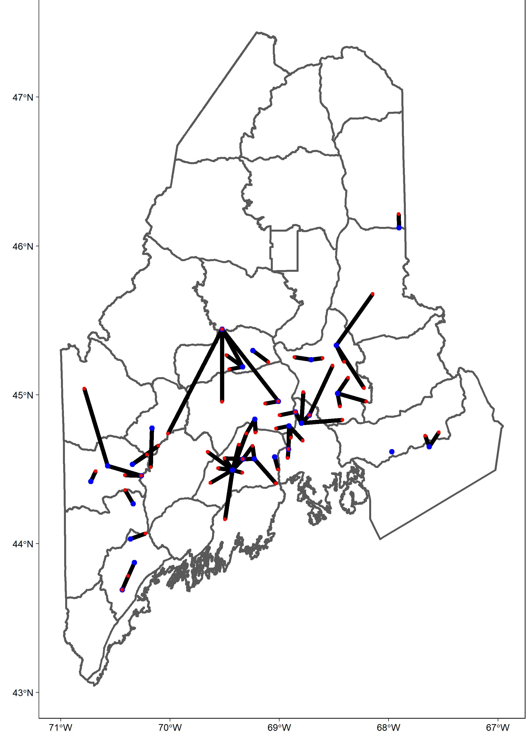
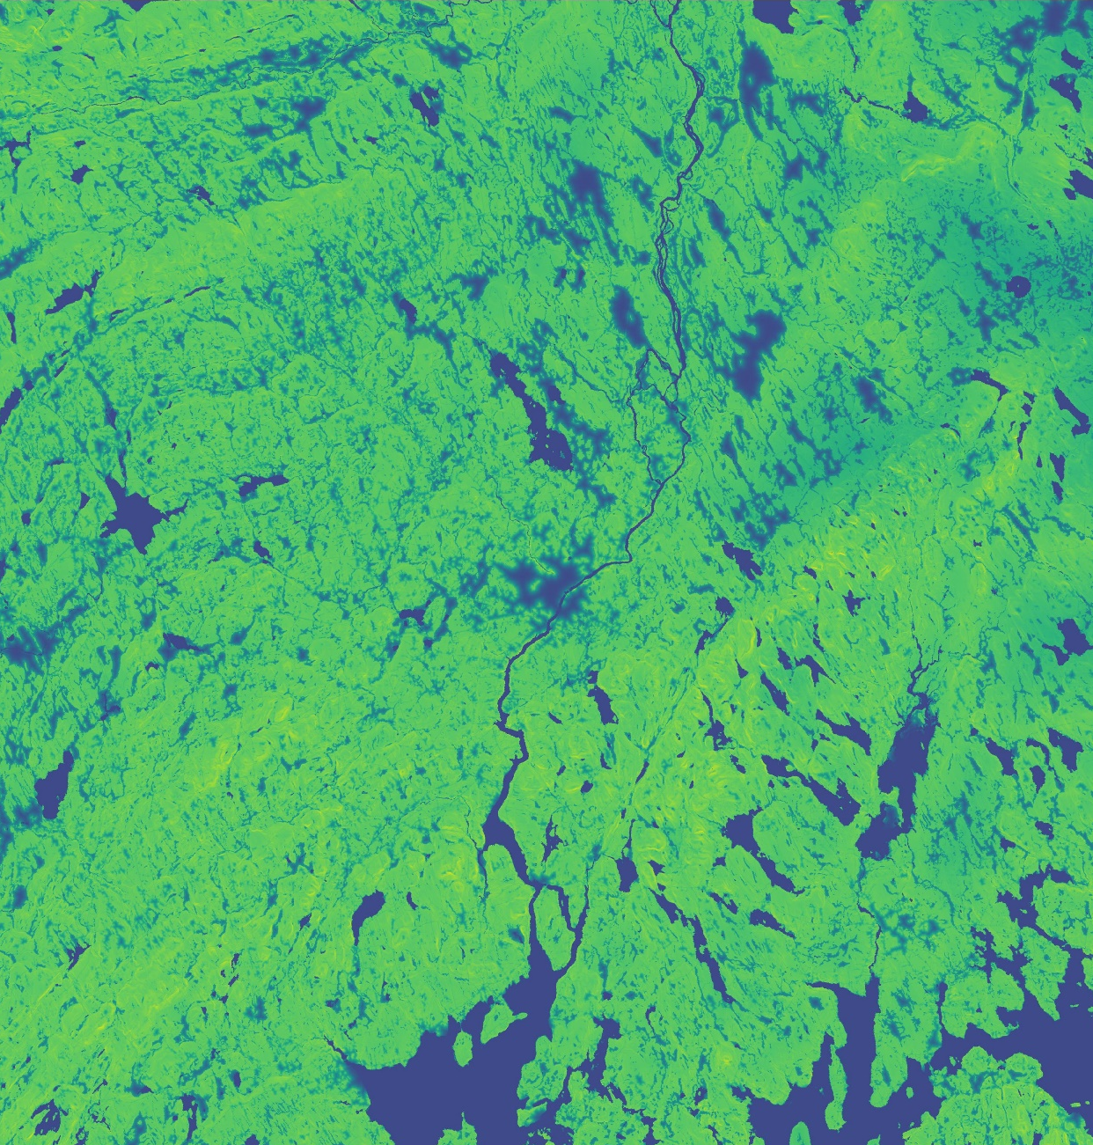
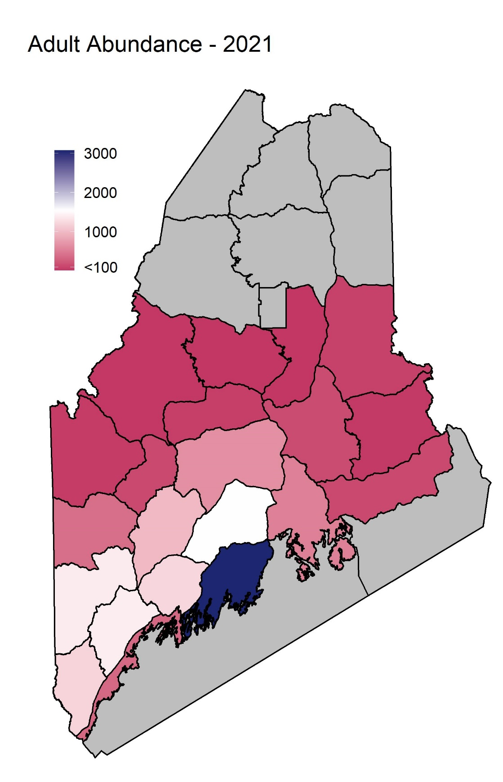
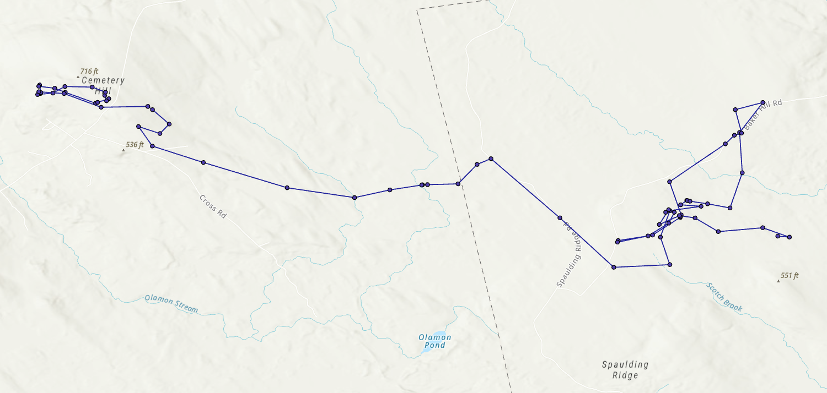
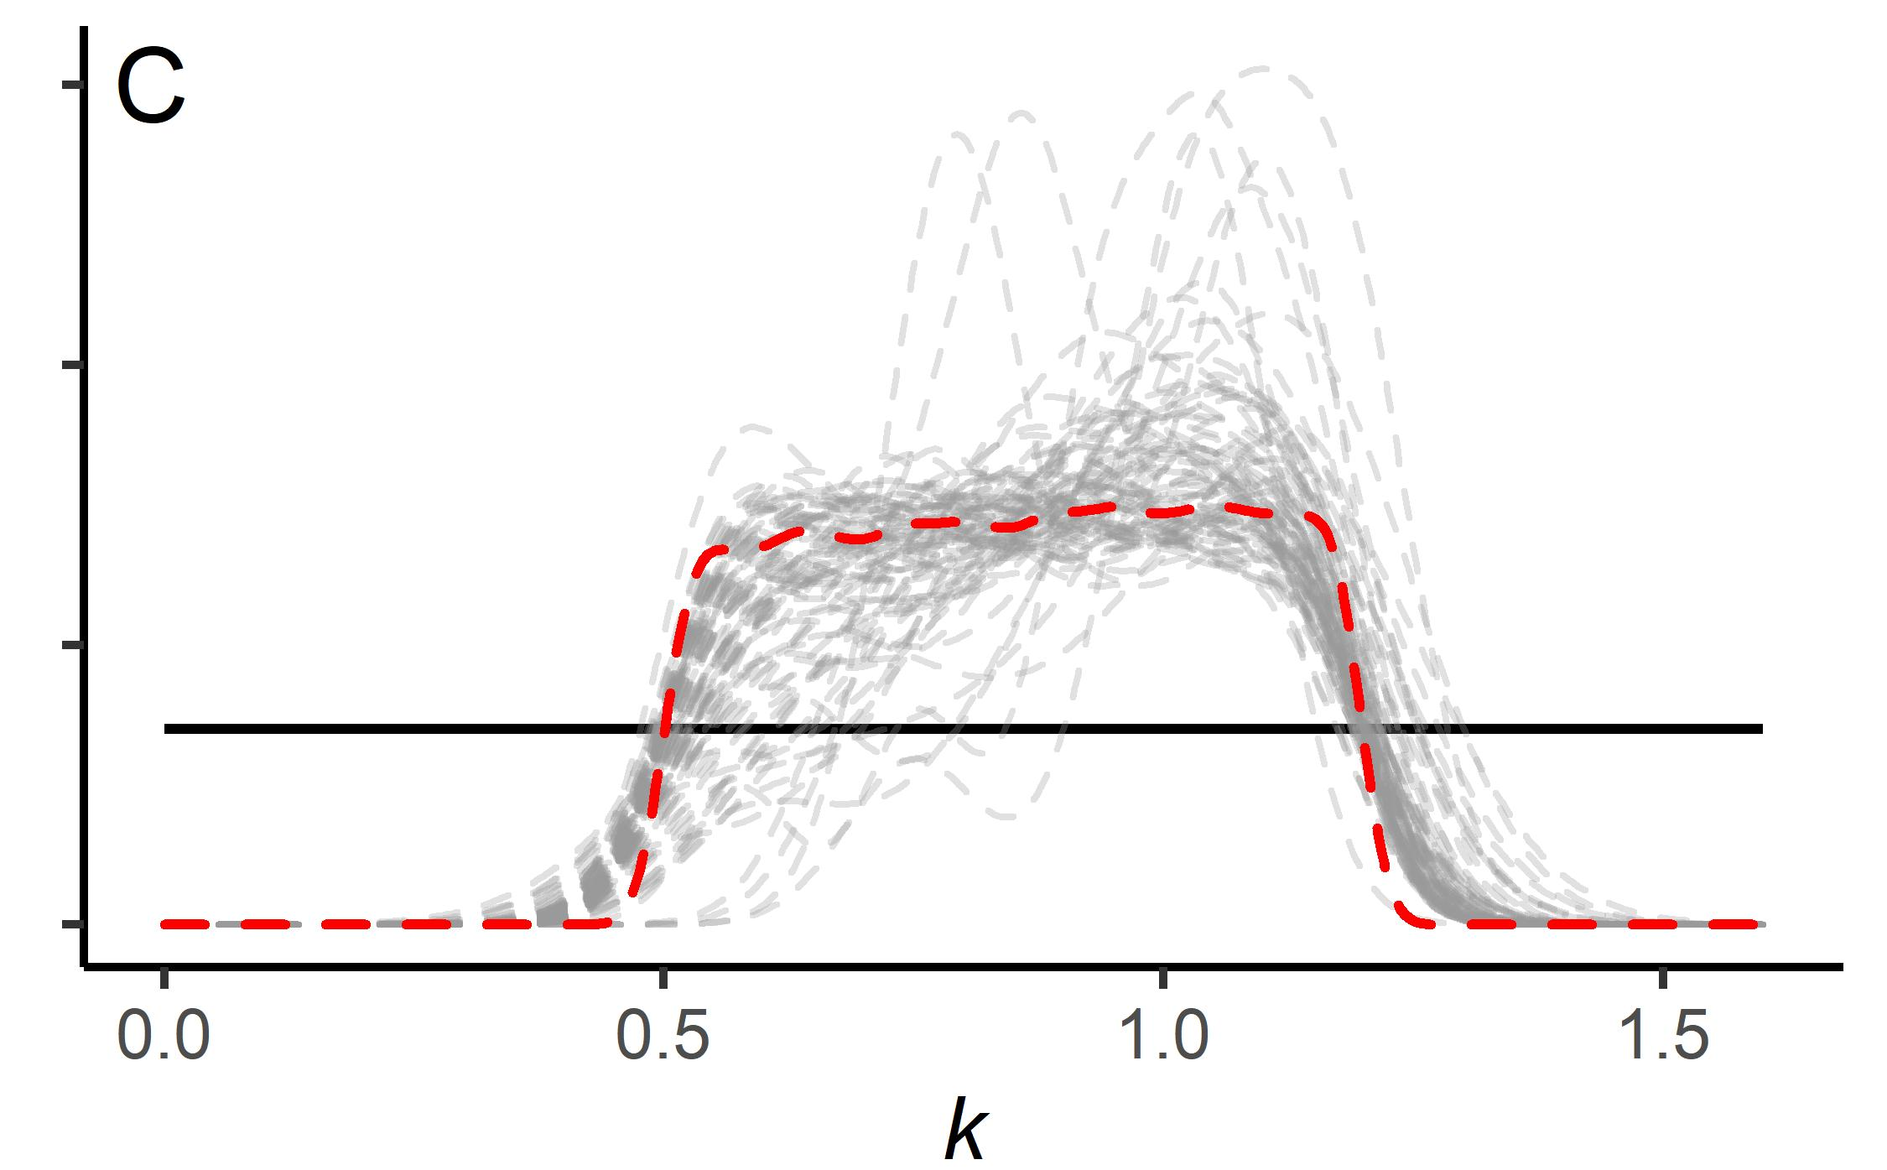
Habitat Covariates:
Seasonal Movement Propensity
Settling Decisions
Nesting and
Harvest Locations
Habitat Suitability Surface
WMD Connectivity Simulation
IPM Abundance Estimates
GPS Tracking Data
IBM Calibration
Individual Based Model

Slide 2
Habitat Covariates:
Seasonal Movement Propensity
Settling Decisions
Nesting and
Harvest Locations
Habitat Suitability Surface
WMD Connectivity Simulation
IPM Abundance Estimates
GPS Tracking Data
IBM Calibration
Individual Based Model

